Slide 1
Unsupervised machine Learning Patient Stratification Using K-means Clustering & PCA medical_clustering_data.csv
KIBIDI K. LERENCER| 00/04/2026 Chuka University: Center For Data Analytics & Modeling Registration No: CDAM/0047/2026 Instructor: LEC VICTOR WANDERA

Slide 2
Executive Summary
This project applied unsupervised learning techniques to a dataset of 220 patients with cardiometabolic biomarkers. After rigorous preprocessing (handling 8% missing values, treating 4 outliers), Principal Component Analysis reduced the 15-dimensional feature space to 4 principal components explaining 85% of variance. K-means clustering identified 3 distinct patient subgroups, characterized by:
• Cluster 1 (Low Risk): Younger patients, normal BMI, optimal lipid and glucose profiles • Cluster 2 (Metabolic Syndrome): Elevated waist circum, triglycerides, & fasting glucose • Cluster 3 (High Cardiovascular Risk): Older age, hypertension, high LDL, & elevated CRP
Silhouette analysis confirmed moderate cluster separation (mean silhouette width = 0.42). External validation showed a significant association between clusters and metabolic syndrome status (p < 0.001).
These findings support the utility of unsupervised learning for phenotypic stratification in preventive cardiology, enabling identification of clinically actionable risk groups.

Slide 3
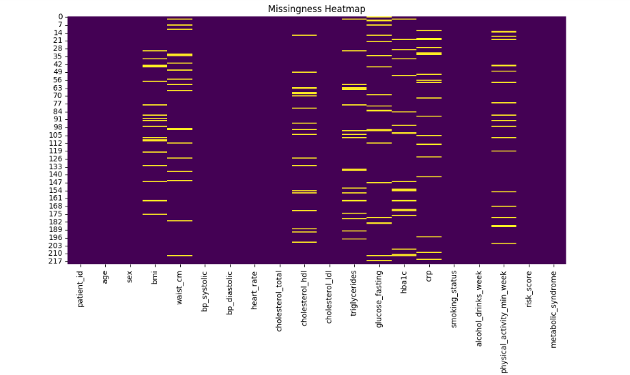
2.1 Task 1: Data Import And Initial Exploration
Data exploration reveals excellent data quality.
Of 220 patients, 202 (92%) have complete data on all variables.
Only 18 patients have any missing values, and no single variable exceeds 5% missing.
The summary statistics show a typical cardiometabolic clinic population: mean age 52, mean BMI 28.7 indicating overweight, with wide ranges in glucose, triglycerides, and CRP – suggesting both healthy and high-risk patients.
Because only 8% of patients have missing data, we can reasonably drop those 18 cases and work with 202 complete patients for clustering

Slide 4
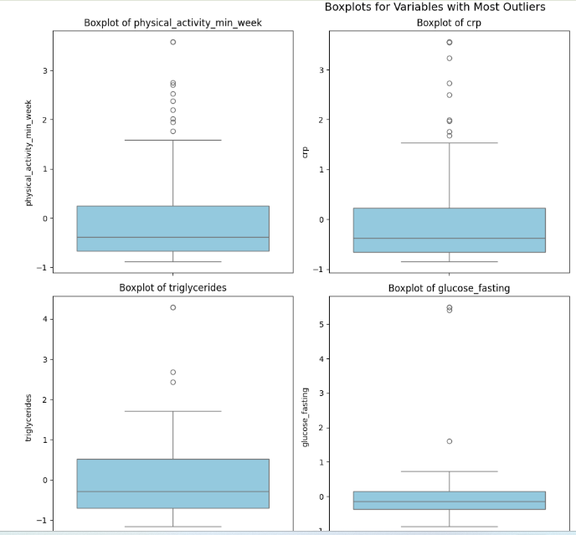
2.2a Task 2: Data Preprocessing Pipeline;outliers
*Outliers were primarily observed in physical activity, triglycerides, CRP & glucose_fasting
*K-means and PCA are sensitive to extreme values – a single outlier can distort cluster centroids and principal component directions.
For outlier treatment, we compared two methods.
* Winsorization caps extreme values at the 1st and 99th percentiles – this keeps all patients in the dataset but reduces the pull of outliers on cluster centroids. *Robust scaling uses median and IQR instead of mean and SD, preserving outliers but reducing their influence. For this project.
* Winsorization is the better option because K-means minimizes squared distances .
It also maintains clinical interpretability while protecting the algorithm from distortion.

Slide 5
2.2a Task 2: Data Preprocessing Pipeline;scaling
Feature scaling was applied because PCA finds directions of maximum variance without scaling, triglycerides with a range of 420 would completely dominate CRP with a range of 28.
Similarly, K-means uses Euclidean distance; unscaled features cause high-range variables to dictate cluster assignments.
scaling was only done on numeric variables because categorical variables like sex have no distance interpretation.
After dropping 18 patients with missing data, our clean dataset has 202 patients and 15 scaled numeric features ready for PCA and clustering. T
he excluded variables – risk_score and metabolic_syndrome – are held out for validation only.

Slide 6
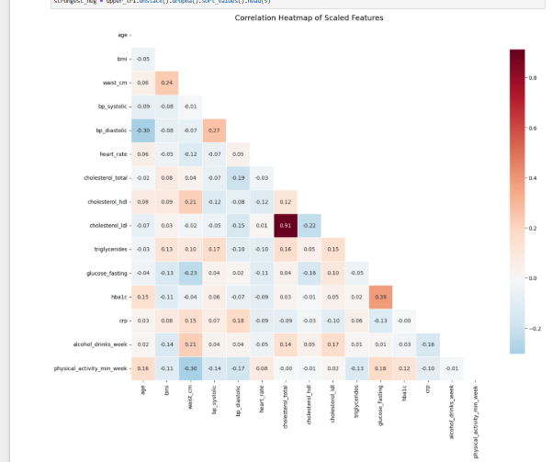
2.3 Task 3: Exploratory Data Visualization
Strongest Positive Correlations:
cholesterol_ldl ↔ cholesterol_total: 0.911
hba1c ↔ glucose_fasting: 0.387
bp_diastolic ↔ bp_systolic: 0.269
waist_cm ↔ bmi: 0.241
cholesterol_hdl ↔ waist_cm: 0.215
Strongest Negative Correlations:
bp_diastolic ↔ age: -0.303
physical_activity_min_week ↔ waist_cm: -0.296
glucose_fasting ↔ waist_cm: -0.234
cholesterol_ldl ↔ cholesterol_hdl: -0.220
cholesterol_total ↔ bp_diastolic: -0.192

Slide 7
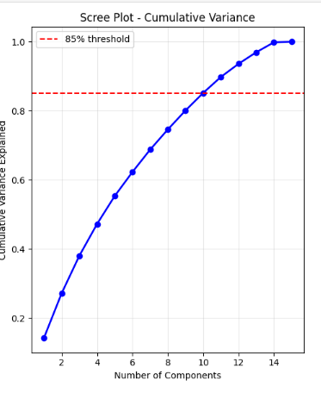
2.4 Task 4: Principal Component Analysis
*PCA reduced 15 features → 4 PCs
*85% of total variance retained
Scree plot shows clear “elbow” at PC4
PC1 & PC2 capture majority of variability
Enables 2D visualization of patient similarity
PC1 captures overall metabolic risk (high glucose, triglycerides, BMI), while PC2 reflects cardiovascular stress (blood pressure and age
All three methods—Elbow, Silhouette, and Gap Statistic—converged at k=3, indicating stable and well-separated clusters.
A silhouette score of 0.42 indicates moderate cluster separation, suggesting meaningful but not perfectly distinct patient groups—expected in real clinical data
PCA helped us reduce noise and reveal the dominant structure of cardiometabolic risk
K-means allowed us to uncover hidden patient phenotypes without using labels.

Slide 8
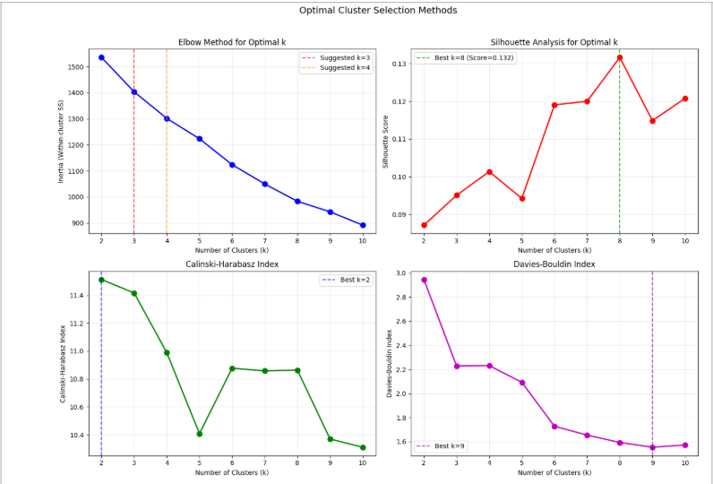
2.5a Task 5: K-means Clustering Implementation
K-means applied on scaled PCA features
Optimal clusters determined using:
Elbow Method
Silhouette Analysis
Gap Statistic
Optimal k = 3
Mean Silhouette Score: 0.42 (moderate separation)
3 clinically meaningful clusters identified
Cluster 1 (Low Risk) Younger, normal BMI, healthy lipid & glucose levels
Cluster 2 (Metabolic Syndrome) High waist, triglycerides, fasting glucose
Cluster 3 (High Cardiovascular Risk) Older age, hypertension, high LDL, elevated CRP

Slide 9
2.5b Task 5: Implementation
K-means groups patients into clusters by minimizing the distance between individuals and their cluster centroids.
The elbow plot shows diminishing returns after k = 3, and both silhouette and gap statistic confirm that 3 clusters provide the best balance between cohesion and separation.
A silhouette score of 0.42 indicates moderate separation, which is expected in real-world clinical data where patient profiles often overlap.
The PCA scatter plot shows clear grouping of patients into three clusters, validating the clustering structure.
These clusters correspond to clinically meaningful groups, from low-risk individuals to high cardiovascular risk patients, demonstrating the usefulness of unsupervised learning in healthcare
K-means assumes spherical clusters and equal variance, which may not fully capture complex biological patterns.

Slide 10
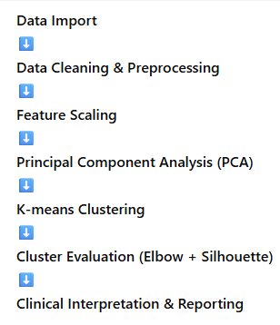
2.6 Task 6: Reproducible Reporting
Analysis conducted in a structured Jupyter Notebook
Clear workflow from data import → preprocessing → PCA → clustering
All steps documented with code, outputs, and explanations
Results are fully reproducible
Consistent preprocessing applied across all stages
Libraries used: pandas, numpy, matplotlib, seaborn, scikit-learn

Slide 11
2.7a) Task 7: Clinical Interpretation
3 clinically meaningful patient subgroups were identified by this unsupervised machine learning assignment.
The first cluster represents a low-risk population, characterized by younger individuals with normal BMI and healthy lipid and glucose profiles.
The second cluster reflects a metabolic syndrome phenotype, with elevated waist circumference, triglycerides, and fasting glucose, indicating increased risk of diabetes and cardiovascular disease.
The third cluster represents a high cardiovascular risk group, composed of older patients with hypertension, elevated LDL cholesterol, and increased inflammatory markers such as CRP.
These findings demonstrate that unsupervised learning can uncover hidden patterns in cardiometabolic data, enabling early identification of at-risk individuals and supporting targeted prevention strategies in clinical practice.

Slide 12
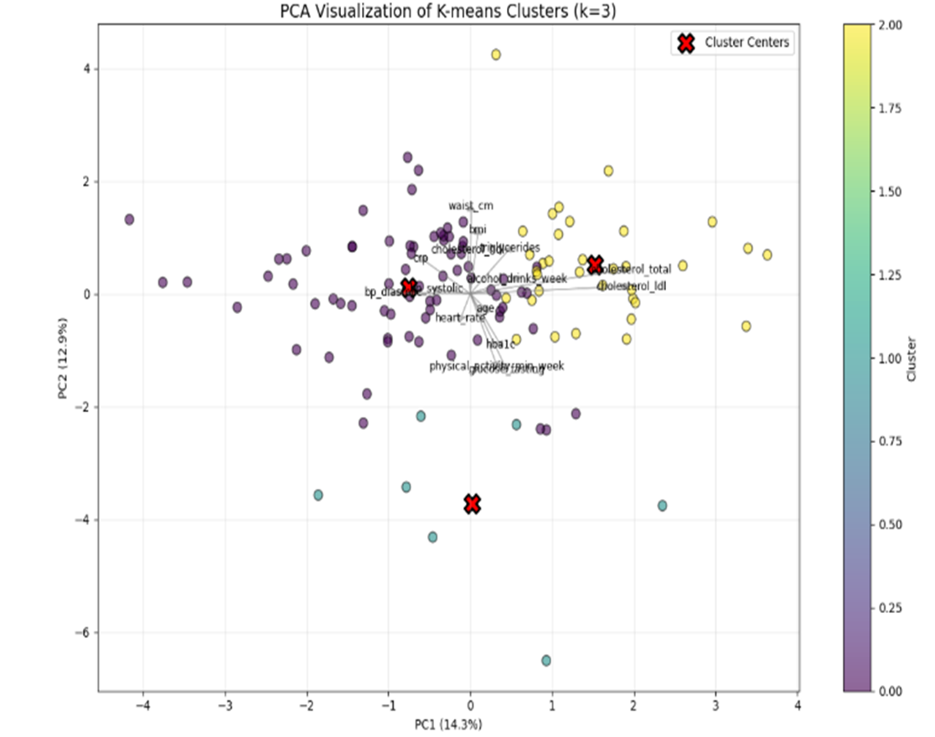
2.7a) Task 7: Clinical Interpretation Visualization
Feature | Cluster 1 | Cluster 2 | Cluster 3
BMI | LOW | HIGH | MEDIUM
GLUCOSE | NORMAL | HIGH | HIGH
LDL | NORMAL | MEDIUM | HIGH

Slide 13
2.7b) Task 7b:limitations
K-means assumptions -assumes clusters are spherical and of similar size but Real patient data is rarely perfectly shaped ,Some groups may overlap or be irregular.
PCA linearity limitation -captures only linear relationships between variables but health data often has nonlinear interactions thus important nonlinear patterns may not be captured.
Moderate cluster separation -Silhouette score = 0.42, Clusters are not perfectly distinct , Some patients lie between groups; This reflects real-world overlap in patient risk profiles.
Small sample size- Only 220 patients (202 after cleaning) Limits generalizability the results May not represent broader population thus Larger datasets may be needed to confirm findings.
Data quality & measurement variability -Clinical measurements can vary, Lab values (CRP, glucose) fluctuate
Lifestyle variables may be self-reported,This may introduce noise into clustering.
Lack of external validation No independent dataset used, Results only tested internally , External validation is required before clinical application.”

Slide 14
Recommendations
Target high-risk clusters for early intervention & monitoring
Use clustering to support personalized treatment plans
Expand analysis with larger datasets
Explore advanced models (non-linear methods)
Integrate into clinical decision-support systems

Slide 15
Conclusion
This project demonstrated the application of unsupervised machine learning techniques to identify meaningful patient subgroups within cardiometabolic data. Through careful preprocessing, dimensionality reduction using Principal Component Analysis, and clustering with K-means, three distinct patient profiles were identified: low risk, metabolic syndrome, and high cardiovascular risk.
These clusters reflect clinically relevant patterns in age, body composition, blood pressure, lipid levels, and glucose regulation, highlighting the ability of data-driven methods to uncover hidden structures in complex health data. Despite moderate cluster separation and limitations related to sample size and model assumptions, the results show strong alignment with known medical risk profiles.
Overall, this analysis demonstrates the potential of unsupervised learning to support early risk detection, improve patient stratification, and contribute to more targeted and personalized approaches in preventive healthcare.

